Slide 1
Using CSS with XML documents
Some browsers, including MSIE 5.5, accept CSS specifications for rendering XML tags

Slide 2
Using CSS with XML documents (contd.)
Consider the XML specification below:
  <?xml version="1.0" ?>
  <!DOCTYPE people SYSTEM "personnel2.dtd">
  <?xml:stylesheet type="text/css" href="personnel2.css"?>
  <people>
  <person>
  <female>Celia Larkin</female>
  </person>
  <person>
  <male>Bertie Ahern</male>
  </person>
  </people>
This refers to a CSS style-sheet whose contents are shown on the next slide

Slide 3
Using CSS with XML documents (contd.)
The contents of the CSS file personnel2.css are:
    male {color : blue; background-color : orange}
    female {color : pink; background-color : green}
Remember that the XML content was:
  <people>
  <person><female>Celia Larkin</female></person>
  <person><male>Bertie Ahern</male></person>
  </people>
Thus Celia Larkin should appear in pink on green while Bertie Ahern should appear in blue on orange
See next slide

Slide 4
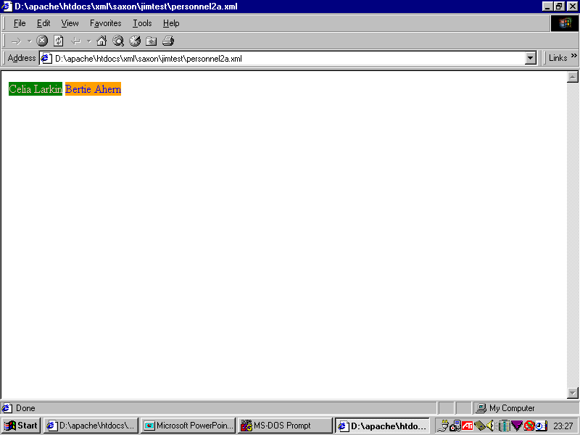

Slide 5
Before we consider XSL ...
Coming from a HTML background, you may assume that web pages only have utility if they are rendered in a browser
However, that is not the case
So, before we consider using XSL to render XML files, we will look at some usage of XML files which does not involve rendering them in browsers

Slide 6
XML applications that do not use browser-rendering

Slide 7
Many XML applications do not need any rendering at all
We will look at a few, based on RSS, an XML application-specific "dialect" (a group of tags and attributes)
We will consider the following RSS applications:
  Newsfeeds
  Podcasting

Slide 8
RSS (Really Simple Syndication)
RSS is a method for syndicating (sharing/distributing) web content
It is an XML dialect
It is widely used by many newspapers and radio broadcasters to syndicate breaking news stories
It is also used for other purposes

Slide 9
A simple example RSS file
<?xml version="1.0" ?>
<rss version="2.0">
<channel>
<title>UCCi Lecture Podcasts</title>
<link>http://www.uccinteractive.tv/test/new/podcasts/index.html</link>
<description>A selection of lectures from UCC</description>
<lastBuildDate>Mon, 12th December 2005 12:30 GMT</lastBuildDate>
<item>
<guid>http://www.uccinteractive.tv/test/new/podcasts/lectures/Patricia Casey.mp3</guid>
<pubDate>Wed, 8 Jun 2005 19:00:00 GMT</pubDate>
<title>Does Mental Illness Exist?</title>
<description>Patricia Casey explores the nature of mental illness.</description>
<enclosure url="http://www.uccinteractive.tv/test/new/podcasts/lectures/Patricia%20Casey.mp3" length="27268689" type="audio/mpeg" />
</item>
<item>
<guid>http://www.uccinteractive.tv/test/new/podcasts/lectures/Brittle bones and breaks.mp3</guid>
<title>Brittle Bones and Breaks</title>
<description>Clive Lee explores the nature of bones and breaks.</description>
<enclosure url="http://www.uccinteractive.tv/test/new/podcasts/lectures/Brittle%20bones%20and%20breaks.mp3" length="16017300" type="audio/mpeg" />
</item>
</channel>
</rss>

Slide 10
RSS (contd.)
An informal description of RSS can be found here:
  http://blogs.law.harvard.edu/tech/rss
Unfortunately, even though RSS is widely used, it took off without a well-defined DTD
A post-hoc DTD (developed by Peter Flynn of UCC) can be found here:
  http://www.silmaril.ie/software/rss2.dtd
However, current usage seems to have diverged from this -- we will modify Flynn's DTD to reflect what appears to be current usage

Slide 11
RSS (contd.)
At the top level, an RSS document contains a <rss> element,
      <!ELEMENT rss (channel)>
      <!ATTLIST rss version CDATA #FIXED "2.0">
The <rss> element has a mandatory attribute called version
        <rss version="0.91">
        ...
        </rss>
We will discuss RSS 2.0, but the following versions of RSS are in use: 0.91 (June 2000), 0.92 (December 2000), 0.94 (August 2002) and and 2.0 (July 2003).
We will also mention the Apple iTunes extension to RSS
  http://phobos.apple.com/static/iTunesRSS.html

Slide 12
RSS (contd.)
The <rss> element has one required child element, the <channel> element:
  this describes an information channel
Apparently, a channel contains a title, link, and description, some optional features and, finally, one or more items. We can represent this as:
  <!ELEMENT channel ( title,link,description,(language|copyright| managingEditor|webMaster|pubDate|lastBuildDate| category|generator|docs|cloud|ttl|image| textInput|skipHours|skipDays)*, (item+) )>
A channel does not have any attributes
The items are the real meat in the sandwich

Slide 13
RSS (contd.)
The title, link, description elements:
    <!ELEMENT title (#PCDATA)>
    <!ELEMENT link (#PCDATA)>
    <!ELEMENT description (#PCDATA)>
The title is the name of the channel -- how people refer to the service.
The link is URL for the HTML website corresponding to the channel.
The description is a phrase or sentence describing the channel.

Slide 14
RSS (contd.)
The optional elements are mostly self-explanatory, but see
      http://blogs.law.harvard.edu/tech/rss
<!ELEMENT language (#PCDATA)>
<!ELEMENT copyright (#PCDATA)>
<!ELEMENT managingEditor (#PCDATA)>
<!ELEMENT webMaster (#PCDATA)>
<!ELEMENT pubDate (#PCDATA)>
<!ELEMENT lastBuildDate (#PCDATA)>
<!ELEMENT category (#PCDATA)>
  <!ATTLIST category domain CDATA #IMPLIED>
<!ELEMENT generator (#PCDATA)>
<!ELEMENT docs (#PCDATA)>
<!ELEMENT cloud (#PCDATA)>
  <!ATTLIST cloud domain CDATA #IMPLIED port CDATA #IMPLIED path CDATA #IMPLIED
registerProcedure CDATA #IMPLIED protocol CDATA #IMPLIED>
<!ELEMENT ttl (#PCDATA)>
<!ELEMENT image (url,title,link,(width|height|description)*)>
<!ELEMENT textInput (title,description,name,link)>
<!ELEMENT skipDays (#PCDATA)>
<!ELEMENT skipHours (#PCDATA)>

Slide 15
RSS (contd.)
Providing a continually-updated list of items is the reason that a rss feed exists
  for example, an rss newsfeed provides a current list of news stories
The specification seems to be:
<!ELEMENT item ((title|description)+,link?, (author|category|comments|enclosure|guid|pubDate|source)*)>
Typically, the title sub-element contains a headline, the description sub-element contains a synopsis and the link sub-element points to the full "story"
If an item contains multimedia objects, pointers to these are in the enclosure sub-elements
For more information ,see http://blogs.law.harvard.edu/tech/rss#hrelementsOfLtitemgt

Slide 16
Newsfeeds
Many news agencies and newspapers provide newsfeeds in the form of RSS files
People can access these newsfeeds through newsfeed aggregators -- special programs which run on the users' computers and whose purpose is to
  continually access those newsfeeds to which a user has subscribed;
  display a "ticker" of headlines
  allow the user to access the full stories

Slide 17
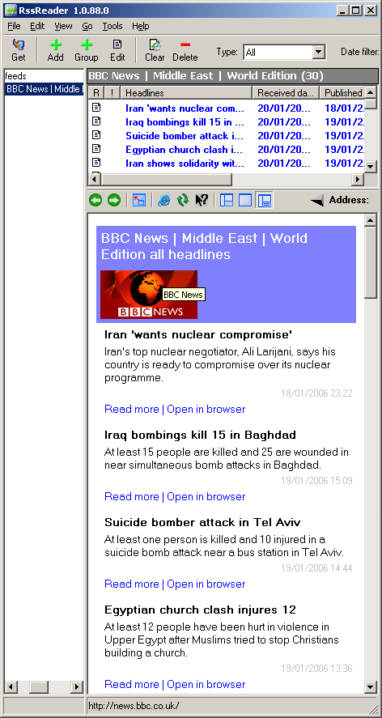

Example newsfeed aggregator
RssReader is can be downloaded here:
http://www.rssreader.com/download.htm
News feeds can be added by simply pasting the URLs for the relevant XML pages into a window provided by the aggregator
For example. to add the BBC newsfeed about the Middle East, one simply pastes
http://newsrss.bbc.co.uk/rss/newsonline_world_edition/middle_east/rss.xml

Slide 18
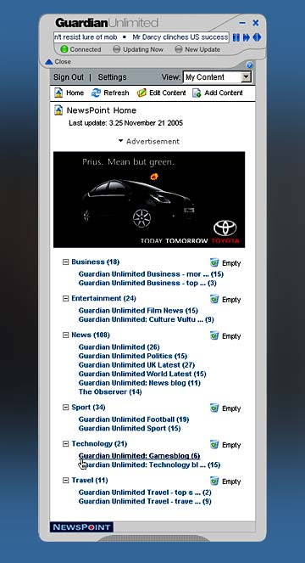
Another example newsfeed aggregator
Newspoint is provided by The Guardian,
It can be downloaded here:
http://www.guardian.co.uk/newspoint
It can be used to keep an eye on breaking news, from the Guardian itself, but also from any other source that provides an RSS newsfeed

Slide 19
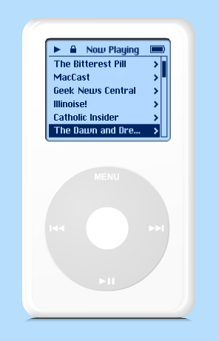
Podcasting
The word "podcast" was coined in 2004
It refers to the automated delivery of audio material to user's desktop computers for later listening on on these or on portable listening devices
Typically the material consists of the most recent editions of radio programmes or audio blogs

Slide 20
Publishing podcasts
When someone (an individual or a broadcaster like RTE) has online audio files that they wish to podcast, they
  place on their website an XML file, called a podcast feed, which lists the available audio files
  most podcast feeds are written using RSS
  however, many sites are using the Apple iTunes extension to RSS
RTE's podcast feed for a program called "Icons of Irish Science" is (2006) at this URL:
  http://www.rte.ie/radio1/podcast/podcast_iconsofirishscience.xml
Here is the podcast feed for UCC's "Last Lecture" series:
  http://www.uccinteractive.tv/test/new/podcasts/ucci.xml

Slide 21
Example: the UCC podcast feed
<?xml version="1.0" ?>
<rss version="2.0">
<channel>
<title>UCCi Lecture Podcasts</title>
<link>http://www.uccinteractive.tv/test/new/podcasts/index.html</link>
<description>A selection of lectures from UCC</description>
<lastBuildDate>Mon, 12th December 2005 12:30 GMT</lastBuildDate>
<item>
<guid>http://www.uccinteractive.tv/test/new/podcasts/lectures/Patricia Casey.mp3</guid>
<pubDate>Wed, 8 Jun 2005 19:00:00 GMT</pubDate>
<title>Does Mental Illness Exist?</title>
<description>Patricia Casey explores the nature of mental illness.</description>
<enclosure url="http://www.uccinteractive.tv/test/new/podcasts/lectures/Patricia%20Casey.mp3" length="27268689" type="audio/mpeg" />
</item>
<item>
<guid>http://www.uccinteractive.tv/test/new/podcasts/lectures/Brittle bones and breaks.mp3</guid>
<title>Brittle Bones and Breaks</title>
<description>Clive Lee explores the nature of bones and breaks.</description>
<enclosure url="http://www.uccinteractive.tv/test/new/podcasts/lectures/Brittle%20bones%20and%20breaks.mp3" length="16017300" type="audio/mpeg" />
</item>
</channel>
</rss>

Slide 22
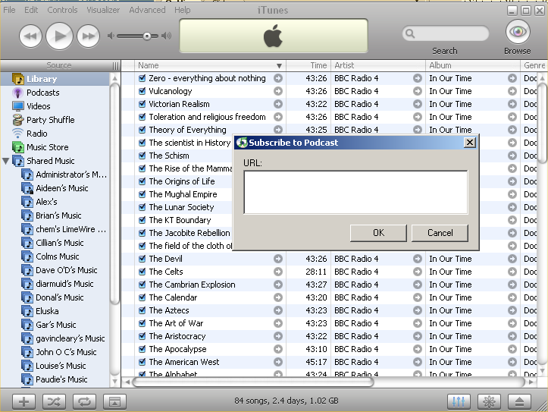
Receiving podcasts
Files from any podcast feed can be received using any of several different programs, for example: Juice or iTunes
These programmes are called aggregators
One simply posts the URL of the podcast feed into an aggregator window and tells the aggregator how often it should check the podcast feed

Slide 23
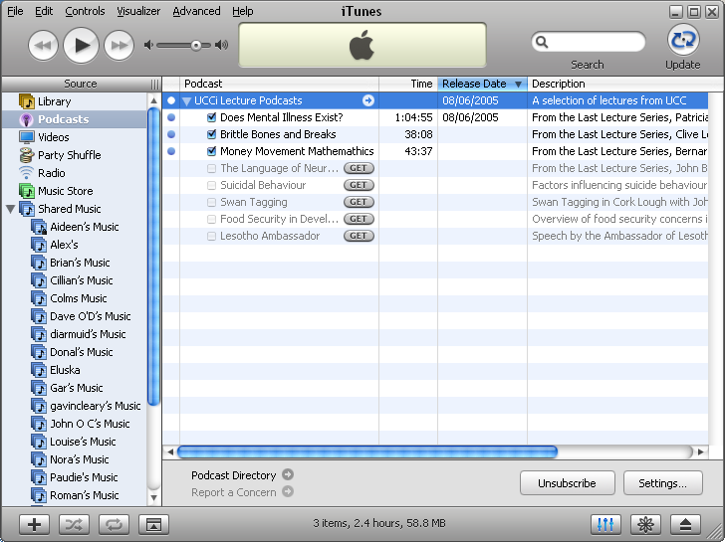
Receiving podcasts (contd.)
The aggregator then
  reads the podcast feed XML file on a regular basis
  identifies which audio files are listed in the feed
  downloads them into local storage
The user can then listen to the audio files whenever this is convenient
Thus, we have a service based on the exchange of XML files, with no need ever to render those files

